Slide 1

Ill-buy E-commerce web shop
Individual project proposal
By Evaldas Drasutis

Slide 2

Is an application which will allow users to buy different house appliance from the online store.
This project will have different challenges that are a good fit for Enterprise software development semester. As I will have to build a software that should be secure and expandable, I believe that E-commerce project will have requirements that suffice the expected learning outcomes. As most e-commerce websites require you to have a dependable architecture to maintain a secure environment for the website users.

Slide 3
For the technology I want to work with some tech that I have worked before but as well to understand it better.(ex. Java, spring boot… )
As well picking up some new tech to learn something new. Such as cloud services.

Slide 4
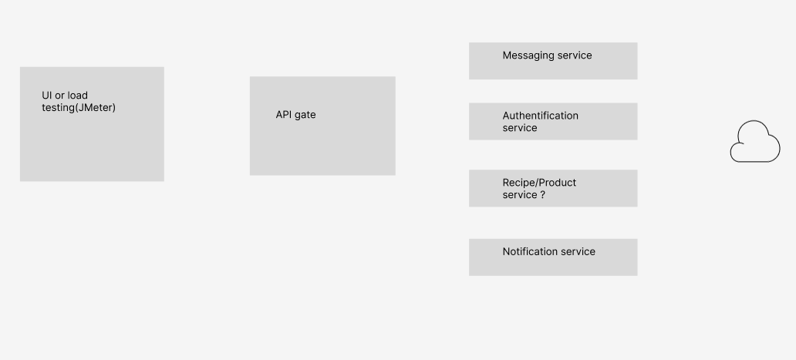
Ill-buy

